Slide 1

Customer Shopping Behavior Analysis
Uncovering insights from 3,900 purchases across product categories to guide strategic business decisions

Slide 2
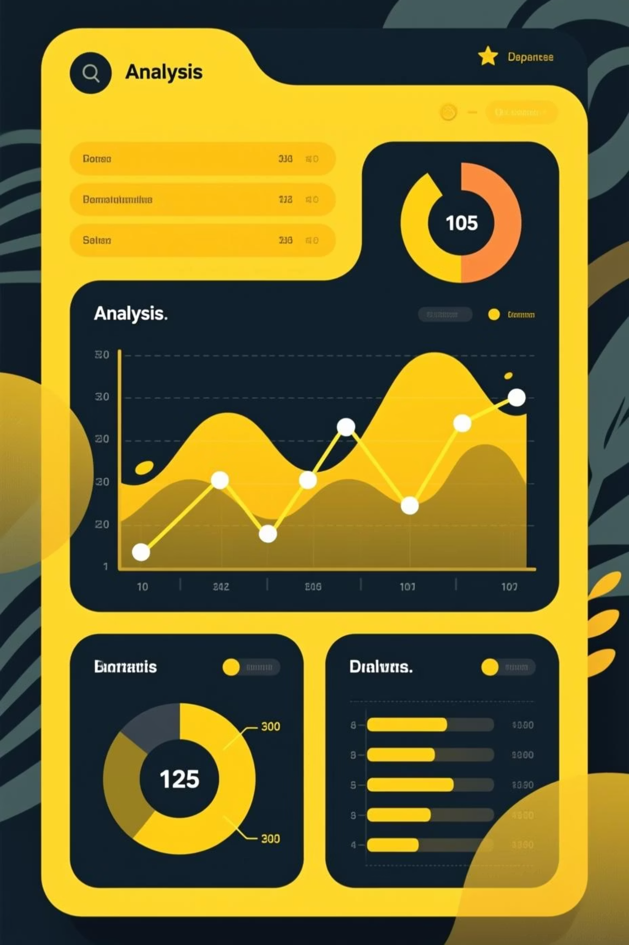
Dataset Overview
3,900 Purchases
18 Columns
Transactional records analyzed
Demographics, purchase details, behavior
37 Missing Values
Review Rating column imputed by category

Slide 3
Data Preparation & Cleaning
01
02
03
Data Loading
Exploration
Missing Data
Imported dataset using pandas
Checked structure and summary statistics
Imputed Review Rating by product category
04
05
Feature Engineering
Database Integration
Created age groups and purchase frequency columns
Loaded cleaned data into PostgreSQL

Slide 4

Revenue Insights
Revenue by Gender
Male: $157,890
Female: $75,191
Male customers generate 2x more revenue

Slide 5
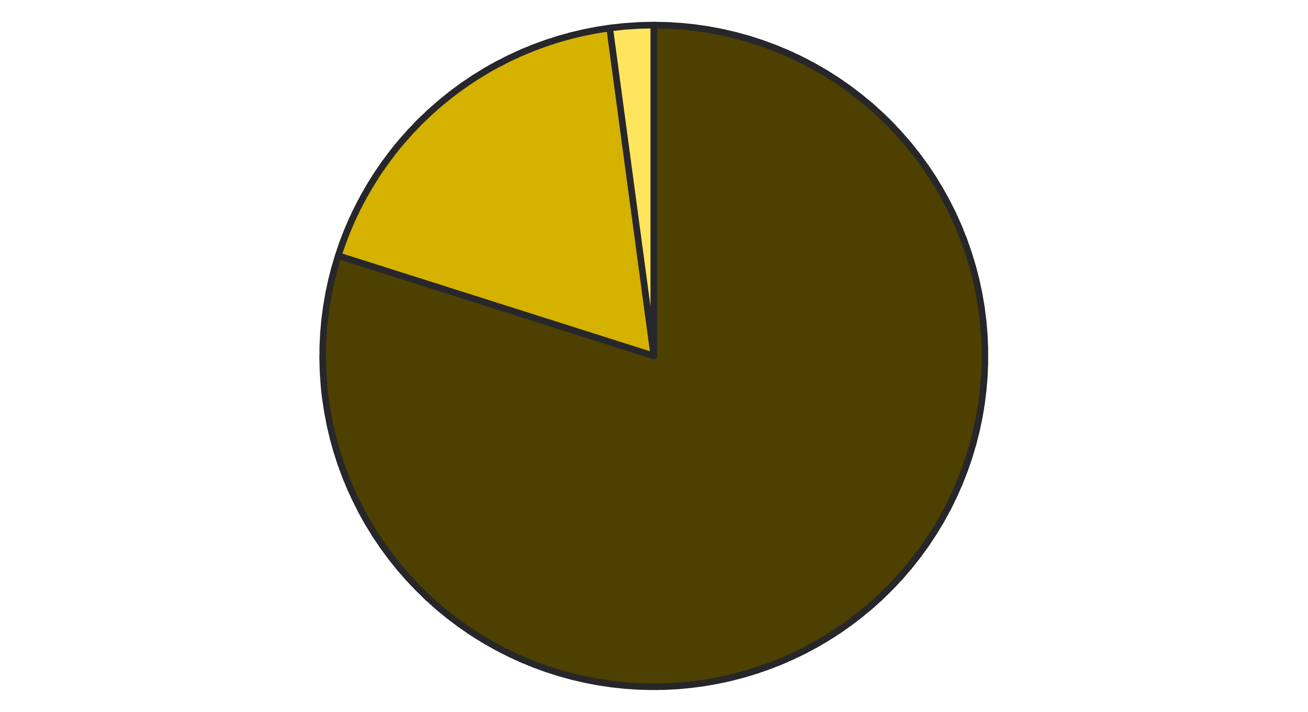
Customer Segments & Loyalty
Loyal
Returning
New
80% of customers are loyal repeat buyers. Returning customers represent growth opportunity.

Slide 6

Product Performance
3.86
50%
171
Gloves
Hat
Blouse
Highest average rating
Highest discount rate
Top-selling clothing item

Slide 7
Subscription Impact
Status
Customers
Avg Spend
Subscribers
1,053
$59.49
Non-Subscribers
2,847
$59.87
Non-subscribers spend slightly more per transaction, but subscribers represent untapped loyalty potential.

Slide 8
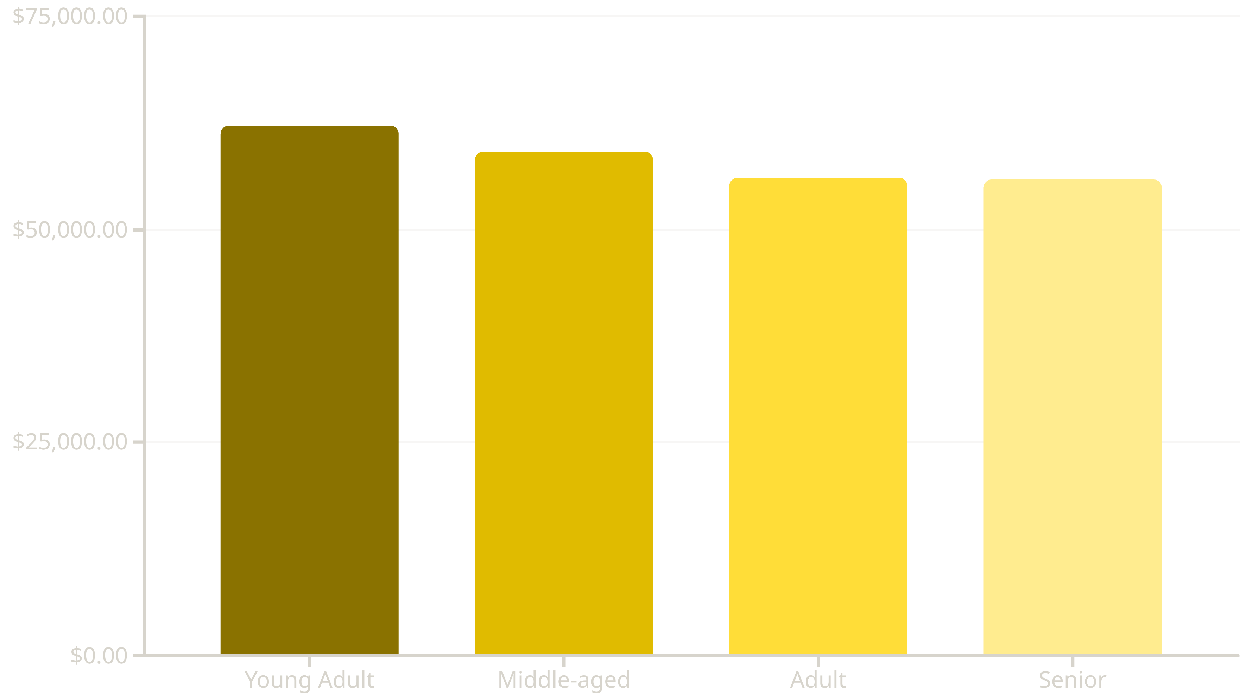
Revenue by Age Group
Young adults drive highest revenue. Balanced distribution across age groups indicates broad market appeal.

Slide 9
Strategic Recommendations
Boost Subscriptions
Loyalty Programs
Review Discount Policy
Promote exclusive benefits to increase subscriber base and lifetime value
Reward repeat buyers to move customers into Loyal segment
Balance sales boosts with margin control—50% discount rate on hats unsustainable
Product Positioning
Targeted Marketing
Highlight top-rated products (Gloves 3.86★) in marketing campaigns
Focus on high-revenue age groups and express-shipping users

Slide 10

Key Takeaways
1
80% Loyal Customers
Strong retention foundation for growth
2
Subscription Opportunity
27% subscriber rate leaves room for expansion
3
Discount Dependency
Review pricing strategy to protect margins
4
Data-Driven Strategy
Use insights to optimize marketing and product positioning

